Slide 1
Industrial Work Placement
Ann Love
Placement Officer
Faculty of Design & Technology

Slide 2
Introduction
Who We Are
Placement Details
Why Choose the Placement Option
Who Does What
Cause for Concern
Past Opportunities
Resources
InPlace
Next Steps

Slide 3
The Placement Office
Frances Hunter Ann Love Nicola Wingate
Placement Manager Placement Officer Clerical Assistant
f.a.hunter@rgu.ac.uk a.love@rgu.ac.uk n.wingate@rgu.ac.uk
Tel: (01224) 262344 Tel: (01224) 262335 Tel: (01224) 262433
Shared mailbox at: placement.destech@rgu.ac.uk
Located in Faculty Office
NS301/301a Sir Ian Wood Building

Slide 4
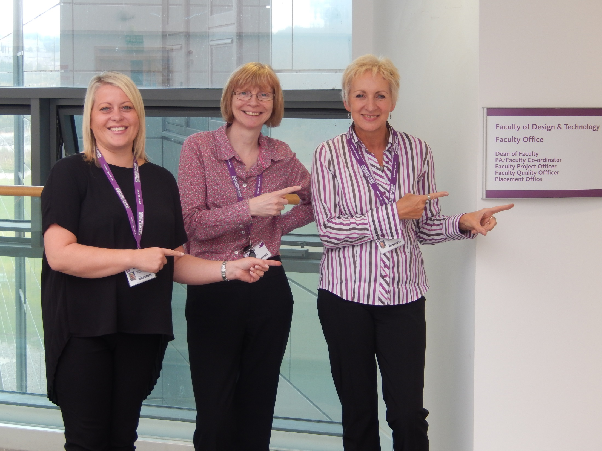

Slide 5
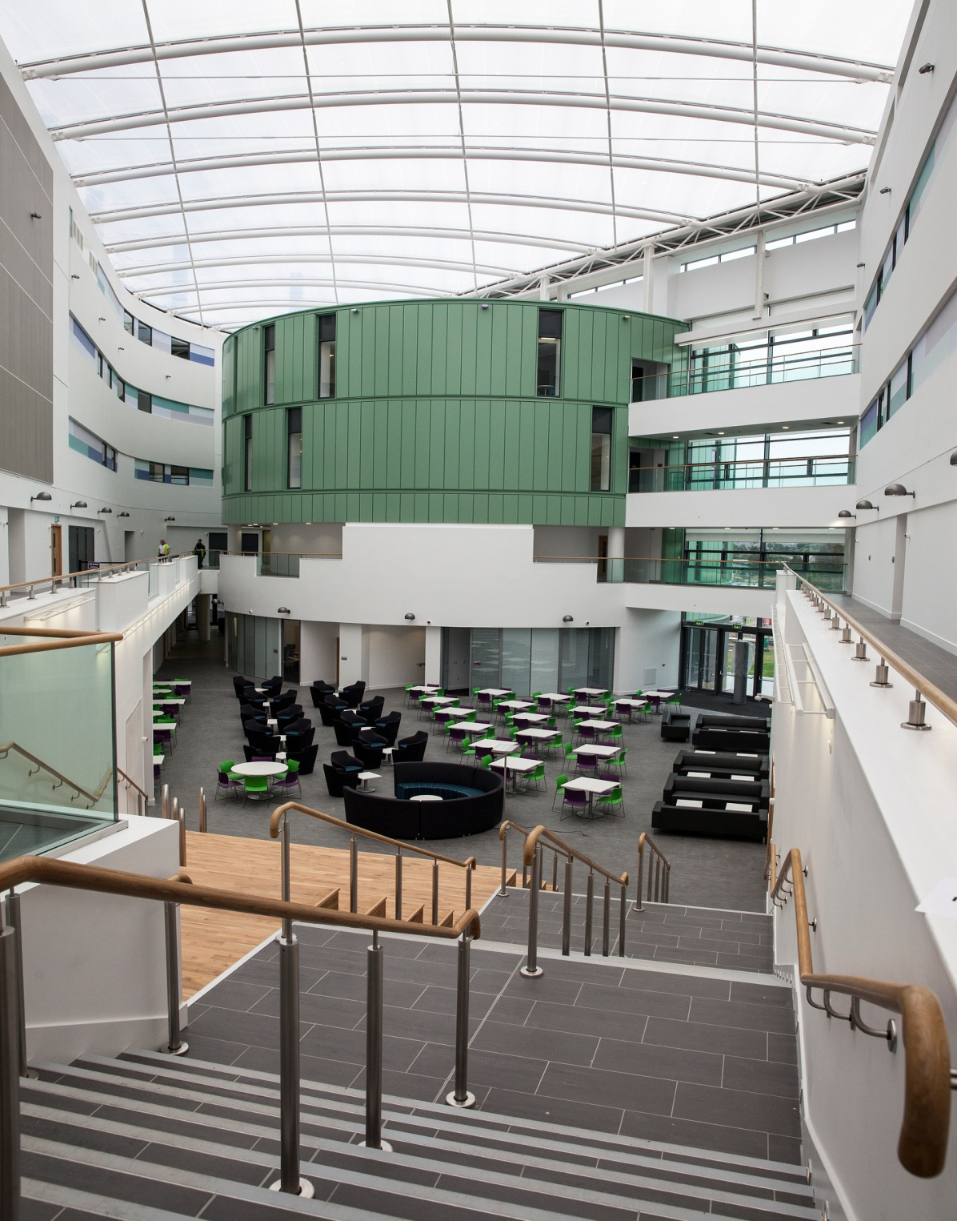

Slide 6
Placement Details
Is not compulsory
Begins 2nd Semester Stage 3 and continues through to the start of Semester 2 Stage 4
Start date 1 February 2016
There may be an option to do a ½ placement
Spent within a relevant organisation
Paid
Assessed by University and your Employer

Slide 7
Placement Benefits
What previous students have told us:
“It’s excellent to put the theory gained over education into practice. My placement has been extremely beneficial and I have gained a part time job while at university from my placement company, and will return to full-time work once qualified.”
“The knowledge gained over the placement has been invaluable. The placement provided a great deal of valuable ‘hands on’ experience allowing me to expand my overall knowledge of the subject and improve on my communication and other personal skills.”

Slide 8
Placement Benefits
“…for me studying my course was very important to get a placement. It is not just to get the first work experience in the industry but also get to know highly skilled engineers from the industry. The whole team in ConocoPhillips was excellent, provided all necessary training, mentoring and later on the opportunity to do my daily tasks without any supervision. I have enhanced my skills not just in a technical way but also increased my confidence and understood the values of teamwork which contributed to continuous improvement.”
And you get paid!

Slide 9
What We Can Do To Help You
Seek placement opportunities in Aberdeen and elsewhere
Advertise placements on InPlace (online system)
Liaise with companies to handle interviews
Make placement offers on behalf of companies
However placements are not guaranteed
Be actively seeking a placement for yourself
We can advise on how to use any existing contacts
We can tell you who we are talking to so we avoid duplication
We can brief prospective placement providers on their commitment if they agree to take you on

Slide 10
What We Can Do To Help You
We will also:
- send out insurance and H&S request forms
- provide pre-placement briefing and relevant documents on Moodle before you embark on your placement
- provide a professional service to students, employers and academic tutors

Slide 11
Your Commitment
Attend timetabled classes
Interact with the Placement Office
Attend CV workshop organised by the Careers Centre
Attend Group Session with Placement Office
Bring signed Placement Registration Form along to Group Session
Check RGU email account, Moodle and InPlace on a regular basis
Have finalised CV ready for applications by 2 November and send copy to Placement Office at placement.destech@rgu.ac.uk
Check for any advertised opportunities
If available, apply via InPlace by closing date
Prepare for interview

Slide 12
Your Commitment
When searching on own behalf:
Check with Placement Office before making “cold call”
Keep us informed of your progress
In either case:
Be professional in your approach
Complete Contacts Form when offer is accepted. This allows the Placement Office to initiate H&S process with your employer. Your placement is not approved until these forms are completed.
Abide by Placement Terms and Conditions (supplied along with Registration Form)

Slide 13
Placement Terms & Conditions
Don’t sign Registration Form without reading T&C first.
Pay particular attention to Number 7.
Issues from 2 years ago:
- failure to attend interview
- terminating placement without good reason
- sending rude email to Placement Office

Slide 14
Your Commitment
Important to note:
If you secure your own placement it must be verified by the University for suitability
Remember to apply to SAAS for funding of 4th year fees
No placement is confirmed until the Placement Office has received insurance and risk assessment forms from your employer

Slide 15
Cause for Concern
If you have any cause for concern contact either your Academic Tutor, Course Leader or the Placement Office (placement.destech@rgu.ac.uk)

Slide 16














Slide 17
Resources
[General Study Area] Faculty of Design and Technology: Placement Process
Careers Centre:
- Seminars and Workshops
- CV feedback
- Employer On Campus events
- Drop-in sessions
The Placement Office also has a twitter account at: @rguplacement
http://www.e-placementscotland.com/
http://uk.linkedin.com/
http://www.equatescotland.org.uk

Slide 18
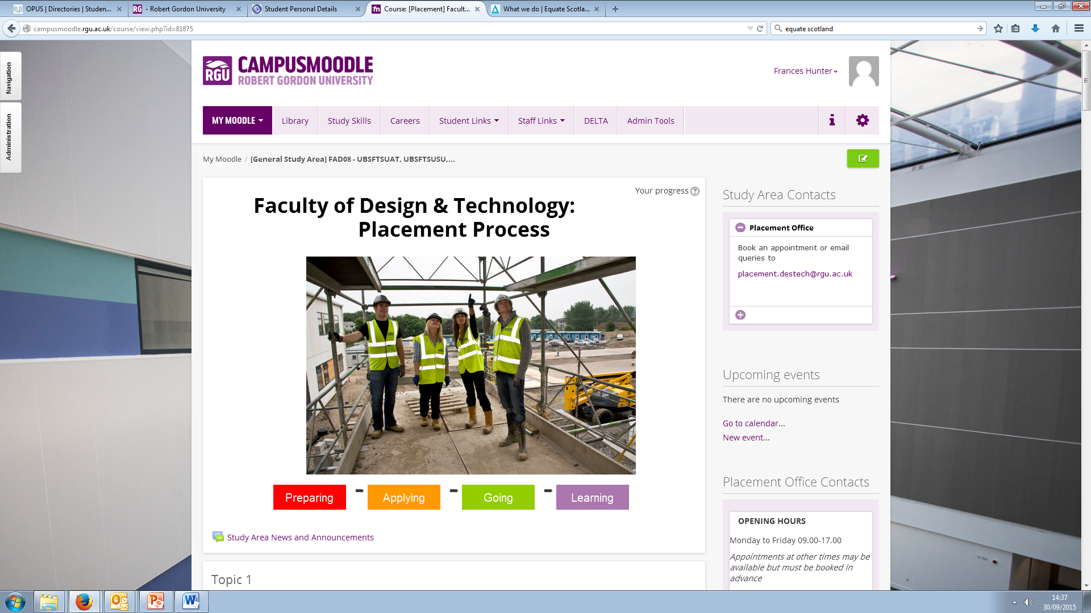
Moodle Placement Pages

Slide 19
InPlace
What is it?
Online placement system where placement opportunities will be advertised
Why use it?
Apply for placement opportunities online
CV & Covering Letter targeted for each application
View vacancies and apply as appropriate
Track the progress of your applications
When the system goes live, you will be enrolled automatically and we will issue further instructions

Slide 20
Next Steps
Register your interest in seeking a placement today
Attend Careers workshop 9 October
Write or update your CV
Complete Placement Registration Form
Read, sign and abide by Placement Terms & Conditions
Attend Group Session with Placement Office bringing signed Placement Registration Form with you
Send copy of your finalised CV to Placement Office by 2 November 2015
Check for placement opportunities on InPlace
Apply by submitting CV to opportunity before closing date
Complete Contacts Form when a placement offer has been accepted and submit to the Placement Office
Start talking to potential contacts from now!

Slide 21
And Finally
“Just a short note to praise the contributions being made by David to the IT team, both locally and globally. He is delivering a lot of value. Many people outside Aberdeen did not realize he was a Student Intern. That is a great testament to his professionalism.”

